Slide 1
Cloud Computing: Introduction to Web Services
Vijay Dialani, PhD
Boise State University
vijaydialani@boisestate.edu
©All rights reserved by the author

Slide 2
Cloud Computing – git repository location
https://github.com/vdialani/CloudComputing.git
Look for examples in “chapter1” folder of this repository.

Slide 3
Cloud Computing – Introduction to Web Services
Web Services is a communication protocol that allows components in distributed systems to exchange messages in accordance to its published interface (specifically WSDL).

Slide 4
Cloud Computing – Introduction to Web Services
Web Services is a communication protocol that allows components in distributed systems to exchange messages in accordance to its published interface (specifically WSDL).

Slide 5
Recap: Distributed Systems I
A Distributed System consists of multiple computational components that communicate over a network in order to achieve a common objective.
Communication between the computers is accomplished by exchange of messages. The semantics and syntax of these messages is specified using a common interface description language.
Components in a distributed system operate concurrently, do not have to be collocated or in same time zone (clocks need not be synchronized) and nodes may fail and recover independently of each other.
There may be no node in the system with complete knowledge of all the computational tasks or the data being handled by the system.
A distributed system may suffer network partitioning and needs to degrade its performance gracefully in face of such failures.

Slide 6
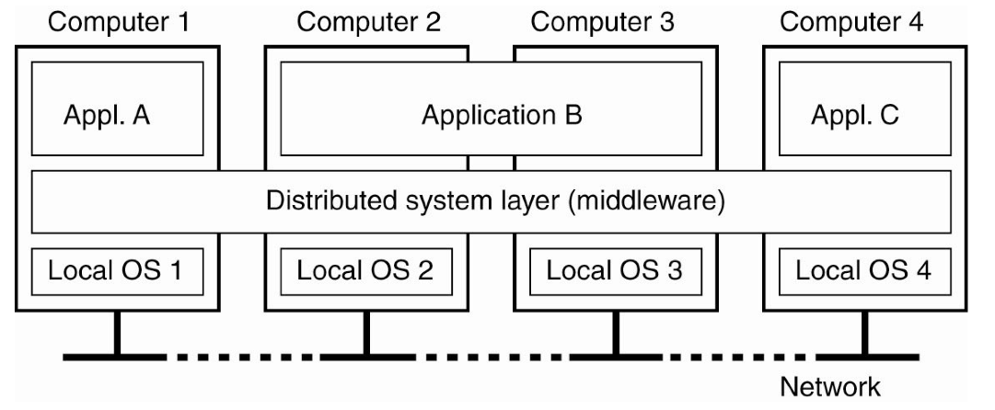
Recap: Distributed Systems II
Distributed System rely on middleware to provide a coherent framework of services to the applications.
Tanenbaum & Van Steen, Distributed Systems: Principles and Paradigms, 2e, (c) 2007 Prentice-Hall, Inc. All rights reserved. 0-13-239227-5

Slide 7
Recap: Distributed Systems III
A Distributed System Middleware:
Provides a Resource Discovery Service
Allows transparent resource migration
Provides the secure context for execution by identifying and authenticating the users and systems
Provides redundancy and replication to hide movement of resources while the system is in use.
Implementations of distributed middleware
CORBA (Common Object Resource Broker Architecture)
DCOM (Distributed Common Object Model)
JAVA-RMI (Java Remote Method Invocation)
Message Queuing Systems ( Rabbit MQ, MSMQ, IBM MQ Series)

Slide 8
Recap: Distributed System IV
Drawbacks of previous approaches
Vendor specific solutions lack of interoperability.
Different binary formats meant many adapter needed to be implemented.
Hard to debug, efficiency requirements dominated and all the data was exchanged in binary format

Slide 9
Recap: Distributed Systems V
Serialization
A way to automatically save and recreate the state of the object.
Serialization converts an object into a byte buffer that could be sent to other systems or could be saved to disc for recreation of the object.
De-serialization converts the byte buffer to an object instance.
Serialization can maintain either a shallow copy or a deep copy of the object.
In a deep copy the nested objects are also serialized and de-serialized to save or recreate an object
Each class used for serialization has an associated serialization ID to verify that the serialized and deserialization process are loading the same version of the class

Slide 10
Recap: Remote Procedure Call
Process A
Process B
C++
Java
Object
Object
Network Pipe
Serialized object
Stub
proxy
Serialized object

Slide 11
Web Services Description Language
A web service description contains definitions about:
simple and complex data types supported by the service
messages that will be exchanged between the server and the client and will be expressed in terms of data types defined and imported by the service
interfaces i.e. port types that will be used to exchange these messages between the client and the server program
bindings that specify the data format and protocol for each of the port types
A WSDL specification is an XML document

Slide 12
Web Service Definition
Web service definition
Abstract Interface describes the type system, the messages, the composition of these messages into operations and ports.
It imposes no requirement of how these messages are exchanged.
Different service implementations may support the same interface
Implementation Details specify the wire format that will be used by the web service instance. The location or endpoint details of the service instance.
It is purely service instance specific information.
Abstract Interface
Types
Messages
Operations
Port Type
Implementation Details
Services and ports
Bindings

Slide 13
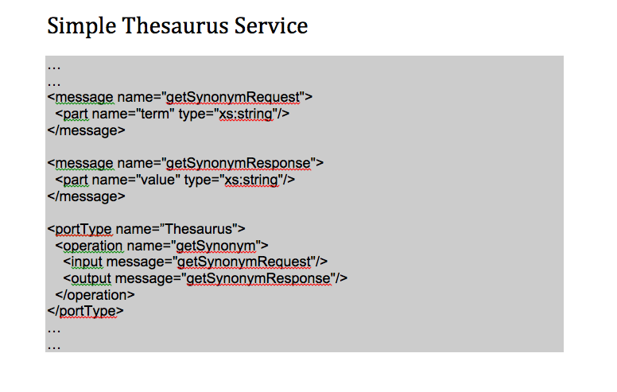
Web Services : Simple Thesaurus Service

Slide 14
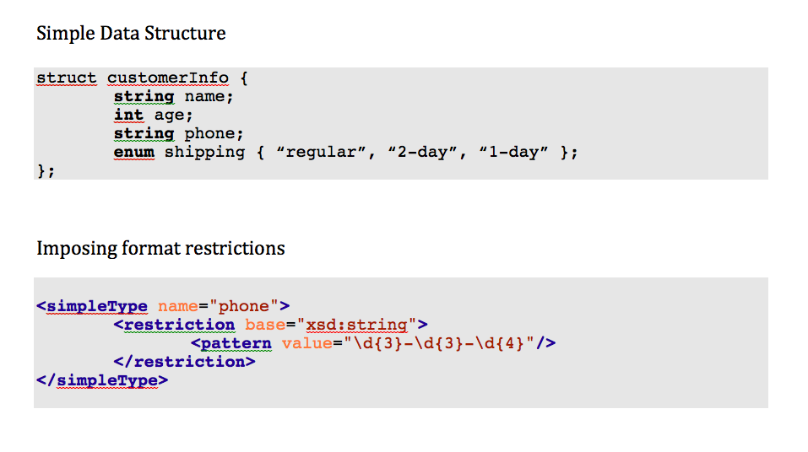
Web Services: Type System

Slide 15
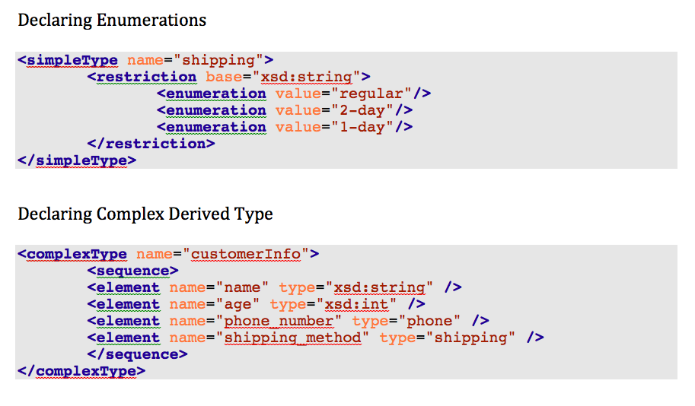
Web Services: Type System

Slide 16
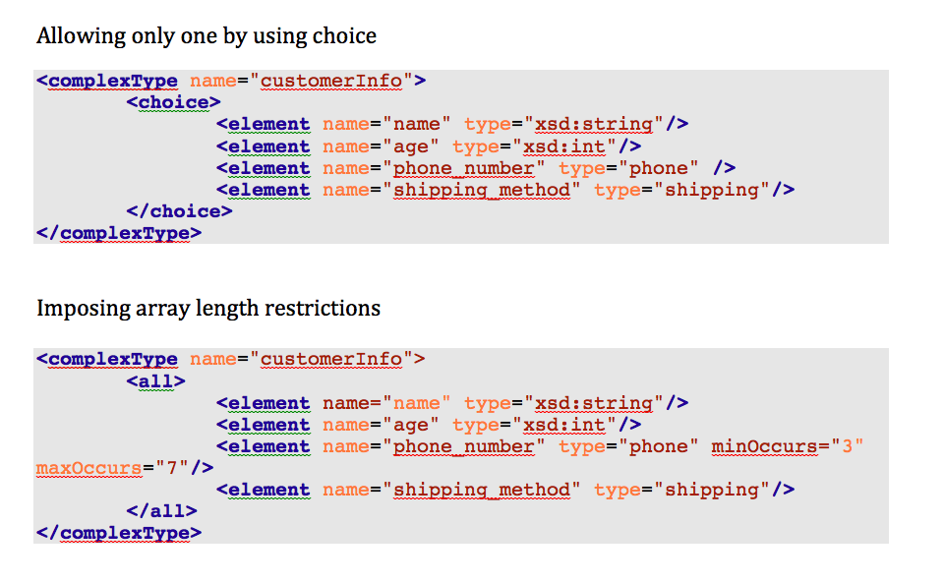
Web Services: Type System

Slide 17
Web Services Definition
Operation Types:
Type | Definition
One Way | The operation can receive a message but will not return a response
Request Response | The operation can receive a request and will return a response
Solicit Response | The operation can send a request and will wait for a response
Notification | The operation can send a message but will not wait for a response

Slide 18
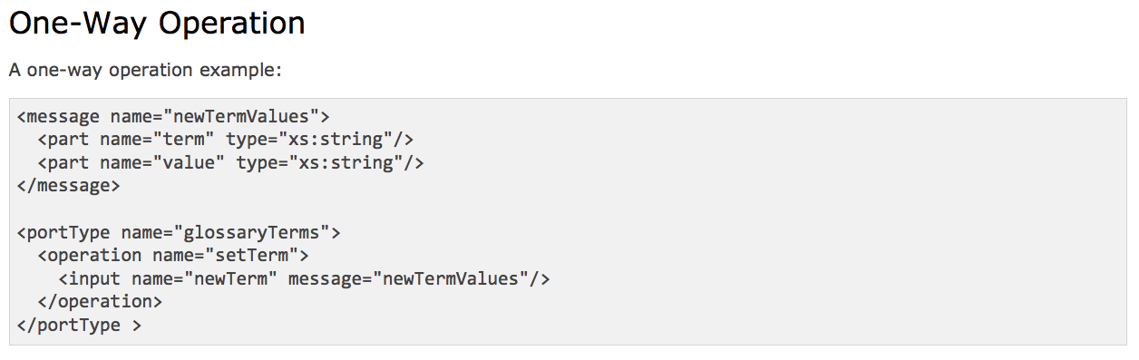
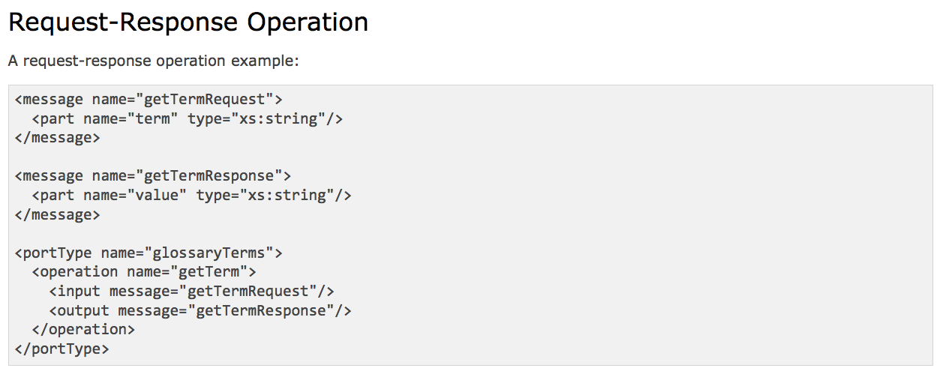
Web Services Operation Types

Slide 19
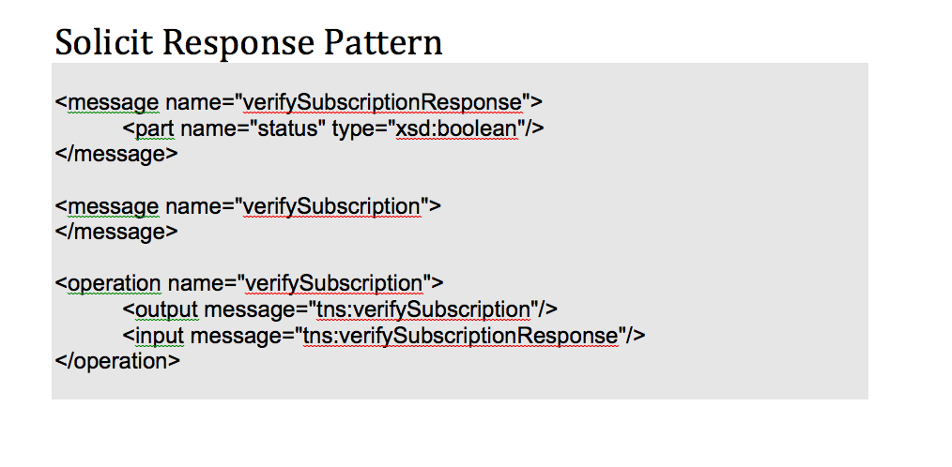
Web Services Operation Types

Slide 20
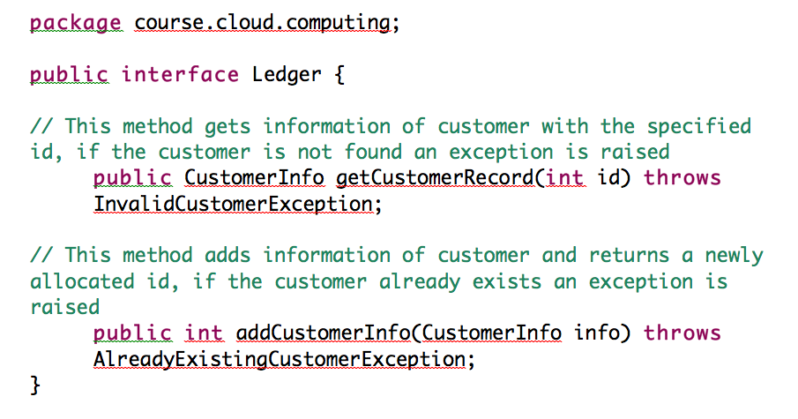
Web Services Ports

Slide 21
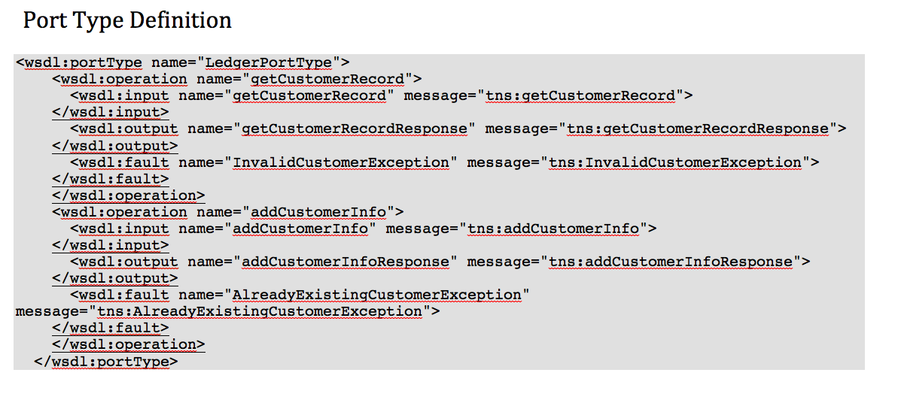
Web Services

Slide 22
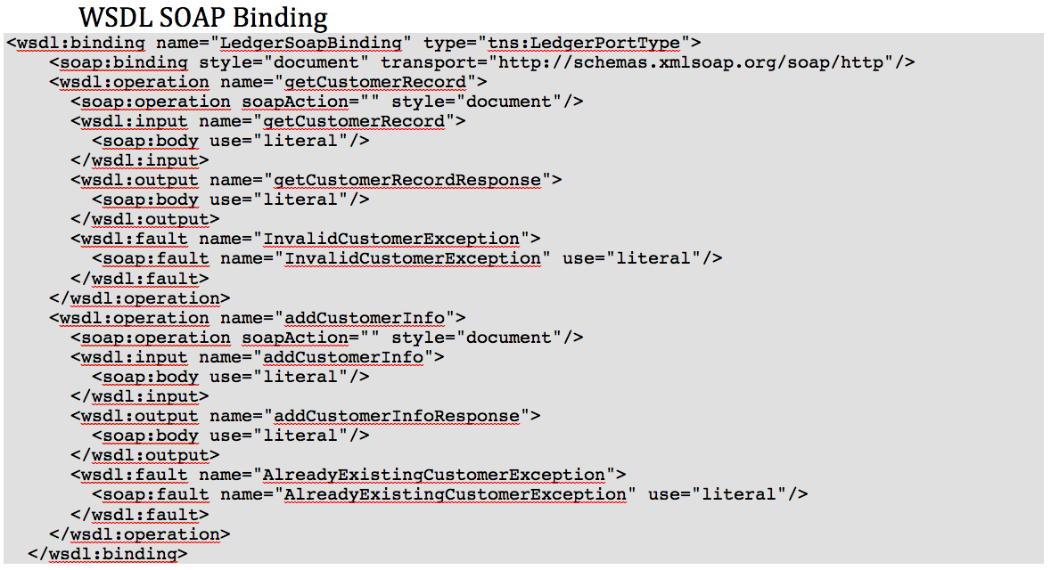
Web Service Binding

Slide 23
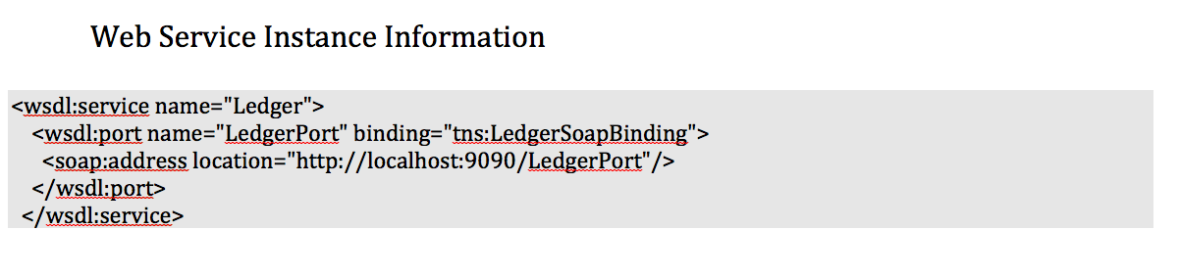
Web Services - Service

Slide 24
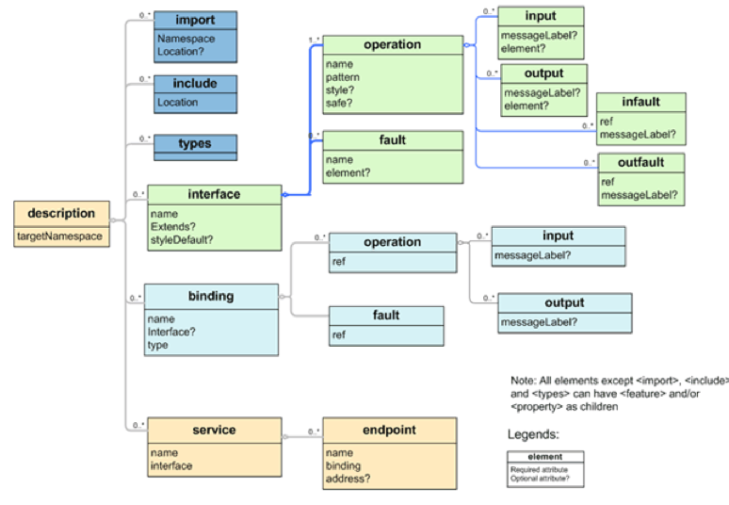
Web Services – XML Namespace Representation

Slide 25
Web Services
WebServices Description Language (WSDL) Version 2.0 Part1:CoreLanguage: http://www.w3.org/TR/wsdl20/#intro
First Look at WSDL2.0:
https://www.sdn.sap.com/irj/servlet/prt/portal/prtroot/docs/library/uuid/74bae690-0201-0010-71a5-9da49f4a53e2

